Slide 1
EMPLOYEE SALARY CLASSIFICATION USING MACHINE LEARNING
CAPSTONE PROJECT
Presented By:
1. Muskaan Walia –Chandigarh University – BE CSE

Slide 2
OUTLINE
Problem Statement (Should not include solution)
System Development Approach (Technology Used)
Algorithm & Deployment (Step by Step Procedure)
Result
Conclusion
Future Scope(Optonal)
References

Slide 3
Problem Statement
This project focuses on building a machine learning-based system to predict employee salary categories based on features like education, experience, job title, etc. Organizations often struggle to decide fair and accurate salary brackets due to subjective biases or manual estimation errors. Our system uses classification algorithms to automatically learn patterns from historical data and suggest appropriate salary categories. The goal is to enhance transparency and consistency in employee compensation decisions. The final solution is deployed as a user-friendly web app using Streamlit for real-time predictions.

Slide 4
System Approach
System Requirements
Operating System: Windows 10 / Linux / macOS
RAM: Minimum 4 GB (8 GB recommended)
Processor: Intel i5 or above
Software Requirements: Python (v3.8+), Jupyter Notebook or VS Code
Web Framework: Streamlit (for model deployment)

Slide 5
System Approach
Libraries Required to Build the Model
pandas – for data manipulation
numpy – for numerical operations
matplotlib and seaborn – for data visualization
sklearn – for preprocessing, model training, and evaluation
xgboost – for advanced boosting algorithms
pickle – to save/load ML models
streamlit – to build and deploy the web app interface

Slide 6
Algorithm & Deployment
Step-by-Step Procedure
Problem Understanding
Identify the objective: Predict employee salaries based on features like experience,
education, location, etc.
Data Collection
Gather or import datasets from .csv or other sources.
Data Preprocessing
Handle missing values
Encode categorical variables (Label Encoding / One-Hot Encoding)
Normalize or scale features

Slide 7
Algorithm & Deployment
4. Exploratory Data Analysis (EDA)
Use matplotlib and seaborn to identify patterns, outliers, correlations
5. Model Building
. Apply multiple models:
🔸 Logistic Regression
🔸 KNN
🔸 Random Forest
🔸 SVM
🔸 Gradient Boosting
Evaluate using metrics like accuracy, precision, recall
6. Model Evaluation
Use confusion matrix, cross-validation, ROC curves, etc.

Slide 8
Algorithm & Deployment
7. Model Saving
Use pickle or joblib to serialize the best-performing model
8. Deployment
Use Streamlit to design a user interface
Load model and accept user input to make real-time predictions
9. Final Testing
Test end-to-end pipeline with different inputs to verify correct output

Slide 9
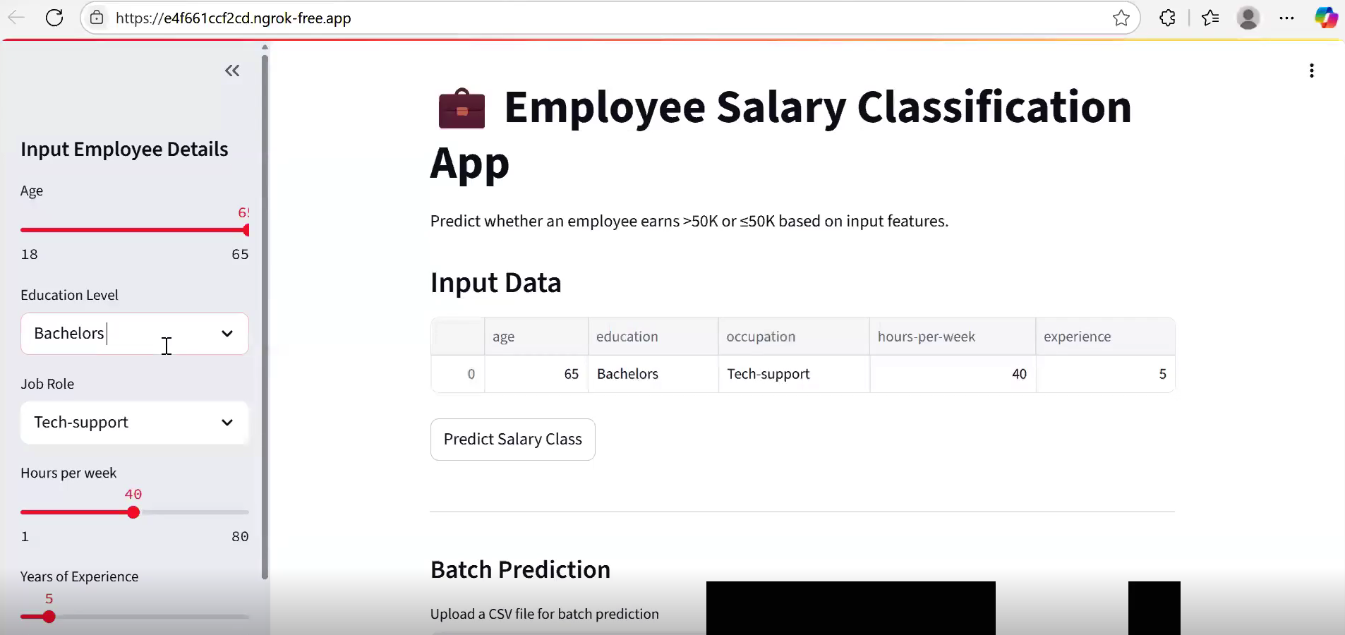
Result

Slide 10
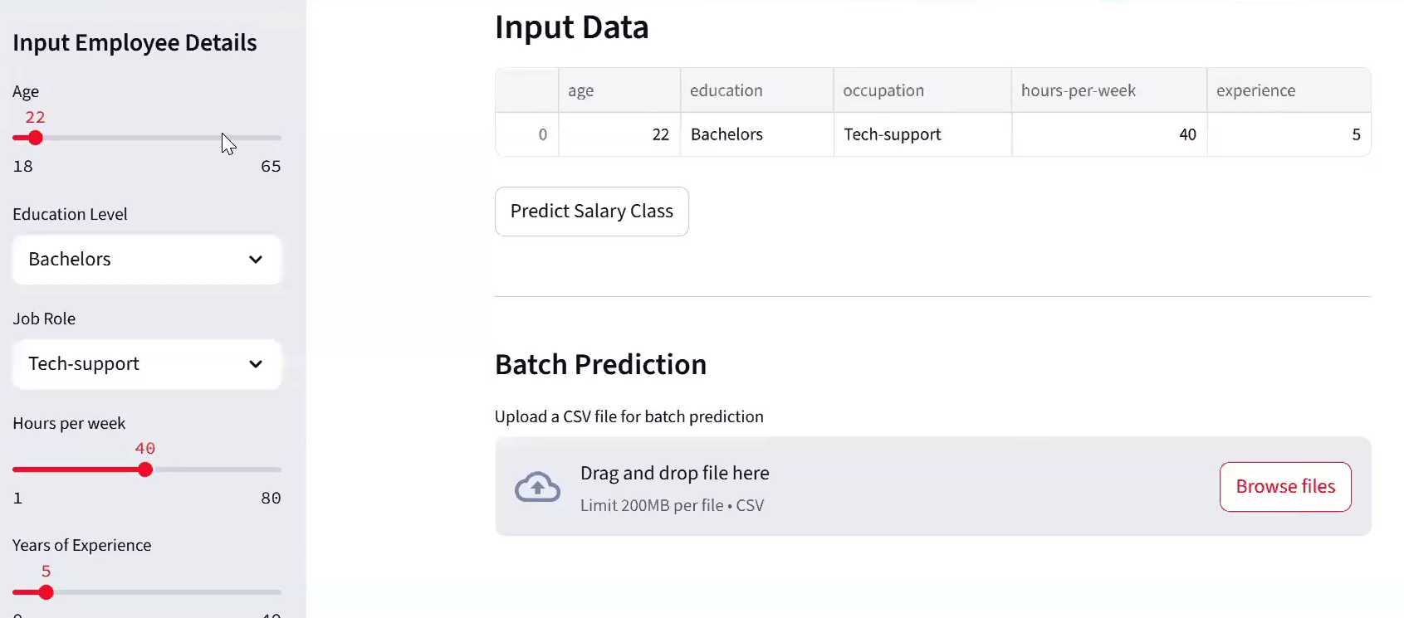
Result

Slide 11
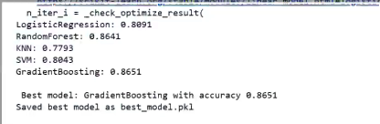
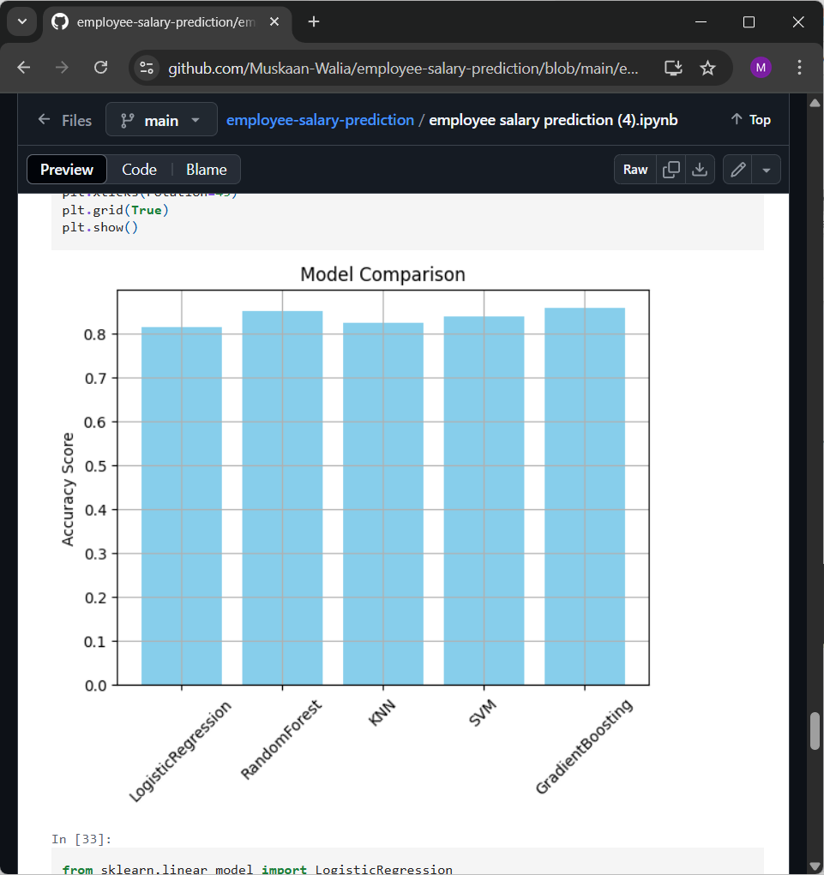
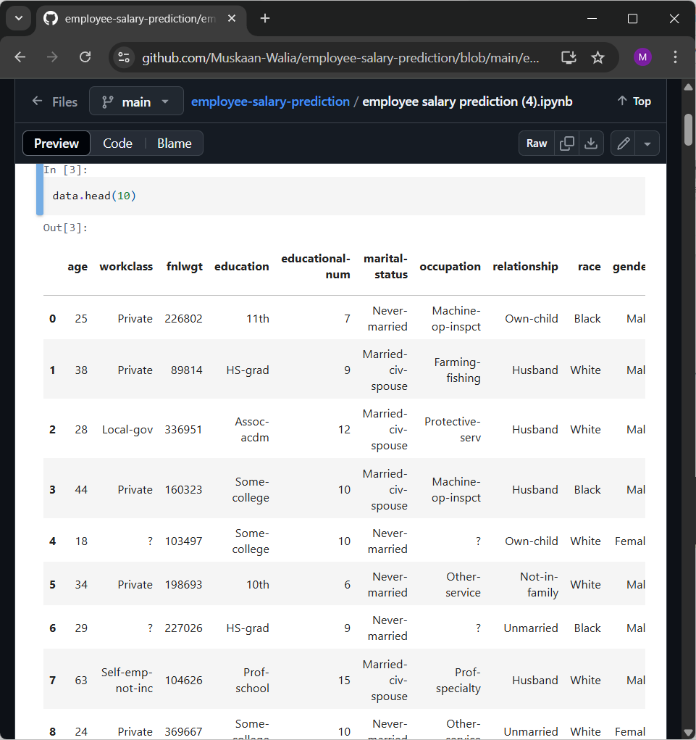
Result

Slide 12
Result
GITHUT LINK –
https://github.com/Muskaan-Walia/employee-salary-prediction.git

Slide 13
Conclusion
✅ This project successfully demonstrates the use of Machine Learning algorithms such as Random Forest, Logistic Regression, KNN, SVM, and Gradient Boosting for predicting employee salaries.
✅ After evaluating the models, the best-performing algorithm was deployed using Streamlit, enabling users to interact with the model via a user-friendly web application.
✅ The solution is effective, scalable, and provides meaningful salary insights based on input features like experience, education, job role, and location.
✅ This project proves that data-driven salary prediction tools can be highly beneficial for HR teams, job seekers, and employers to make informed decisions.

Slide 14
Future scope(Optional)
🔹 Real-time Prediction: Integrate the system with real-time employee data feeds for instant salary prediction.
🔹 Advanced Algorithms: Include deep learning models like Neural Networks or ensemble methods like
XGBoost and CatBoost for better accuracy.
🔹 Dynamic Web Interface: Enhance the Streamlit frontend into a full-fledged web app with user authentication,
history tracking, and options.
🔹 Scalability with Cloexportud: Host the model on cloud platforms (AWS, GCP, Azure) to support larger organizations
and remote access.
🔹 Explainability & Bias Detection: Incorporate SHAP or LIME to explain predictions and ensure model fairness
across demographics.

Slide 15
References
[1] Scikit-learn Documentation https://scikit-learn.org/stable/
[2] Streamlit Docs – Deploy ML Web Apps https://docs.streamlit.io/
[3] Kaggle – Employee Salary Prediction Dataset https://www.kaggle.com/
[4] Géron, A. (2019). Hands-On Machine Learning with Scikit-Learn, Keras & TensorFlow (2nd Ed.). O'Reilly Media.
[5] Research Paper: "Predicting Salary using Machine Learning Techniques" IEEE, 2021

Slide 16
THANK YOU

